Slide 1
PRASHANT MISHRA
SOUNDLY The Complete Sound Effects Platform

Slide 2
Let’s play a quick game

Slide 3
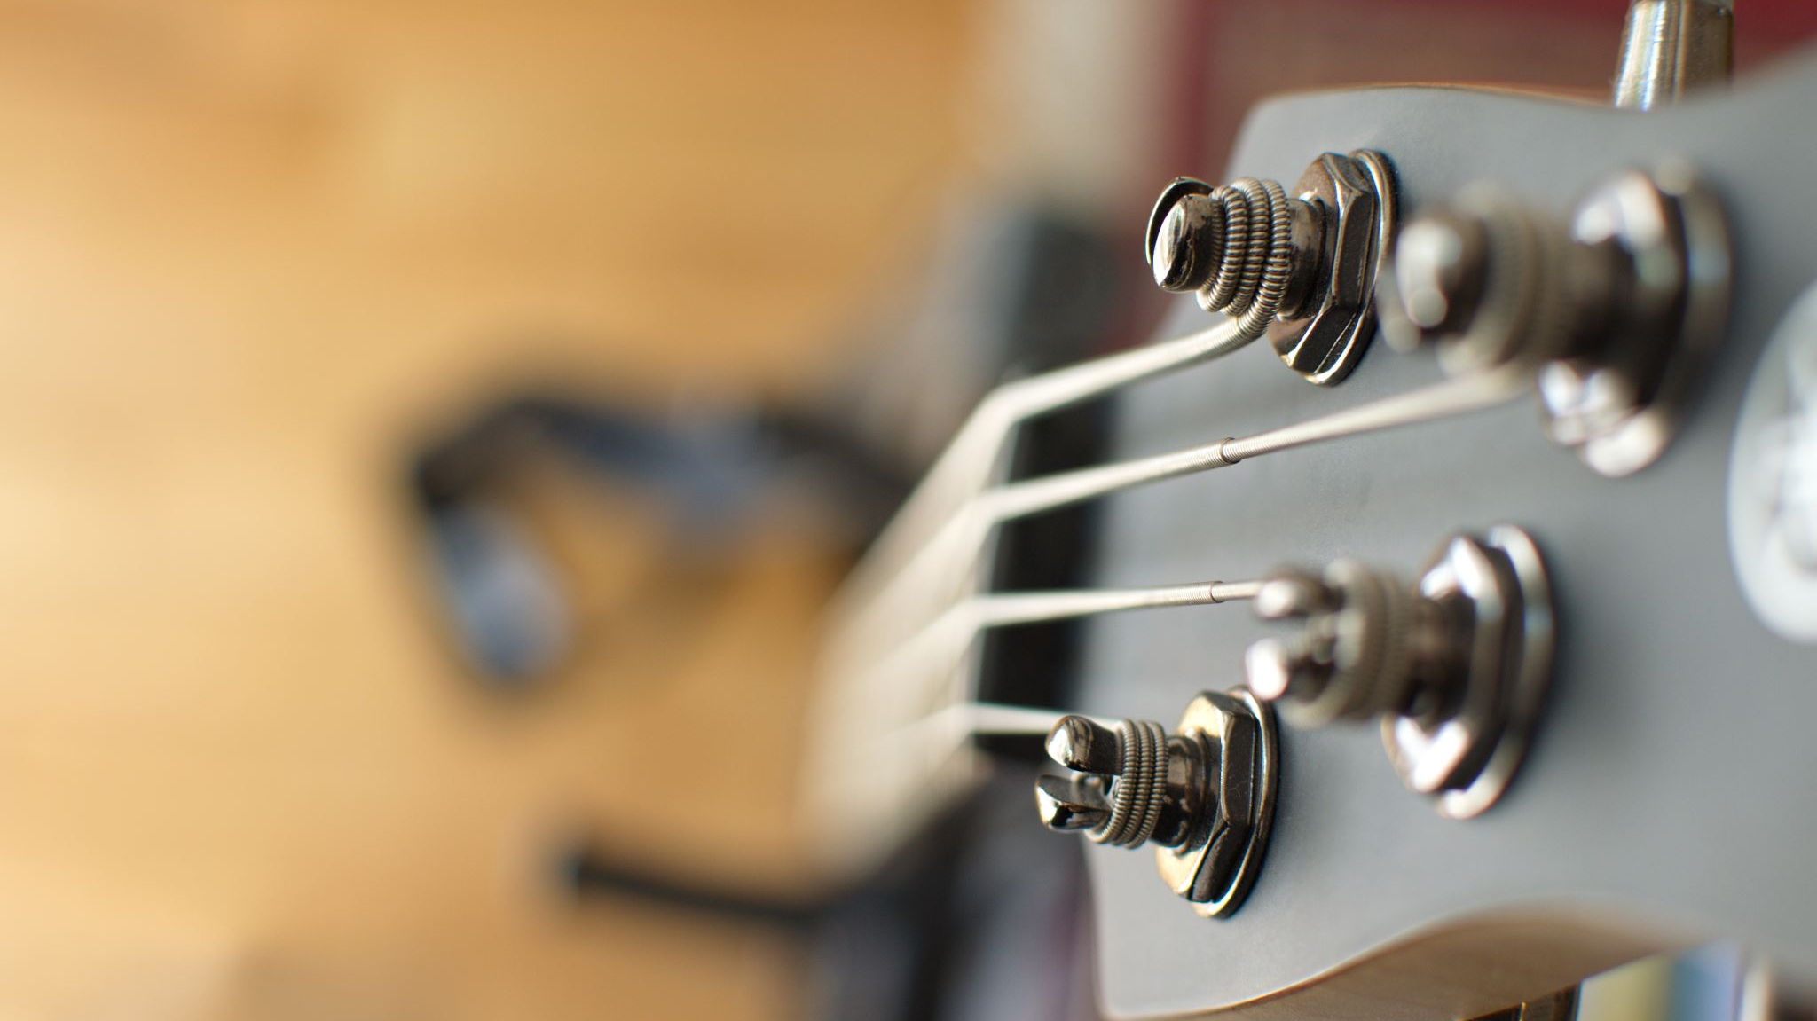
Building games & interactive audio experiences is like conducting an orchestra. The difference is that instead of doing it live, we write our instructions in code, directly or indirectly. We get to predict and control the future, by thinking ahead of it. - Prashant

Slide 4
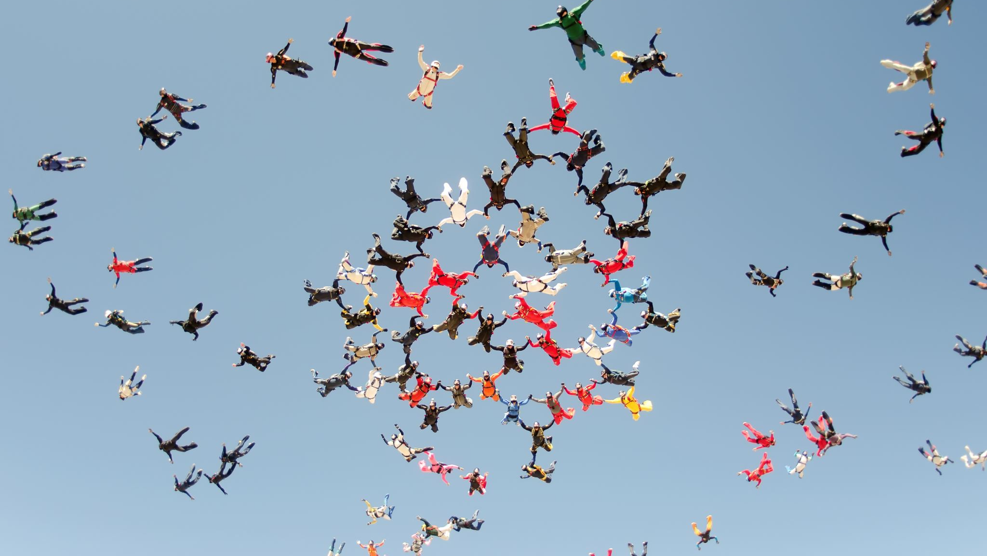
Who is in the audience?

Slide 5
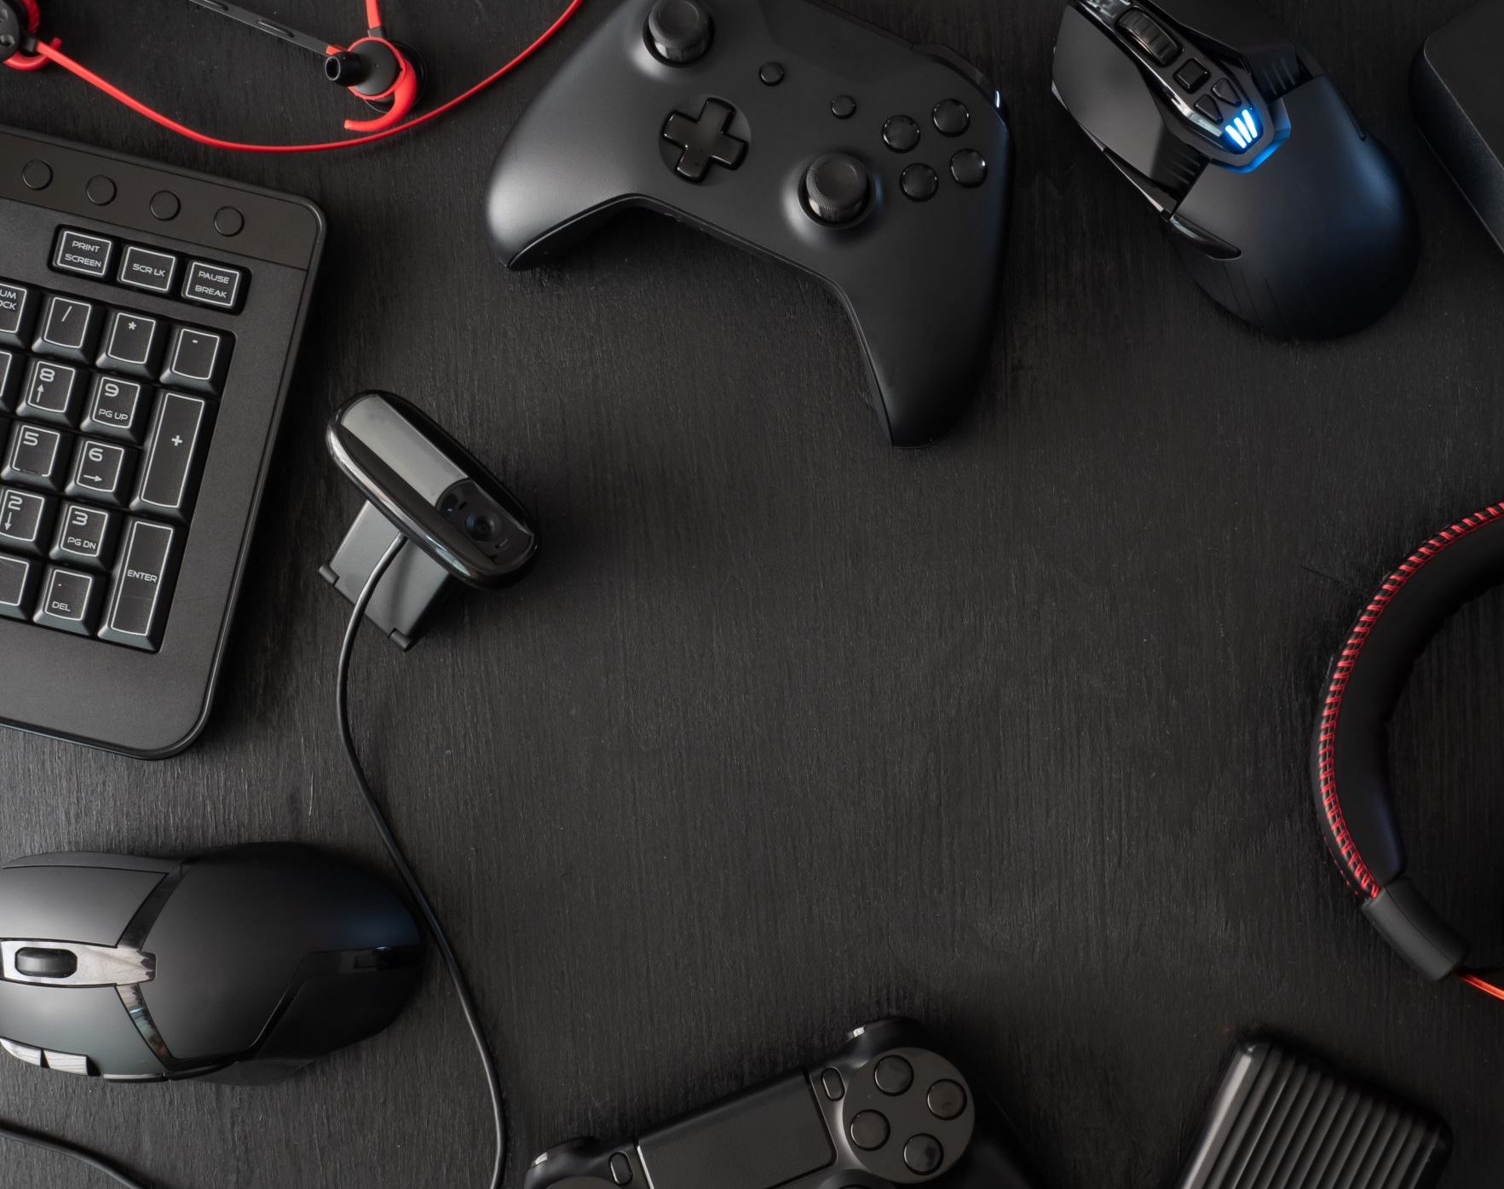
Building a Game Audio Mindset a guide for scalable audio implementation by Prashant Mishra

Slide 6
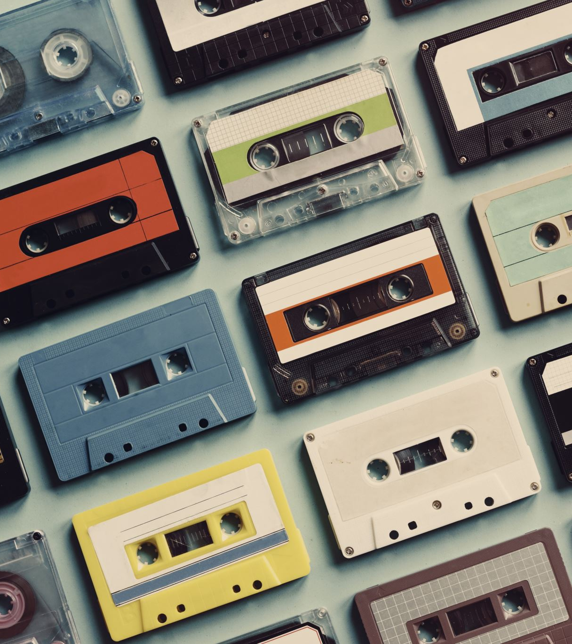
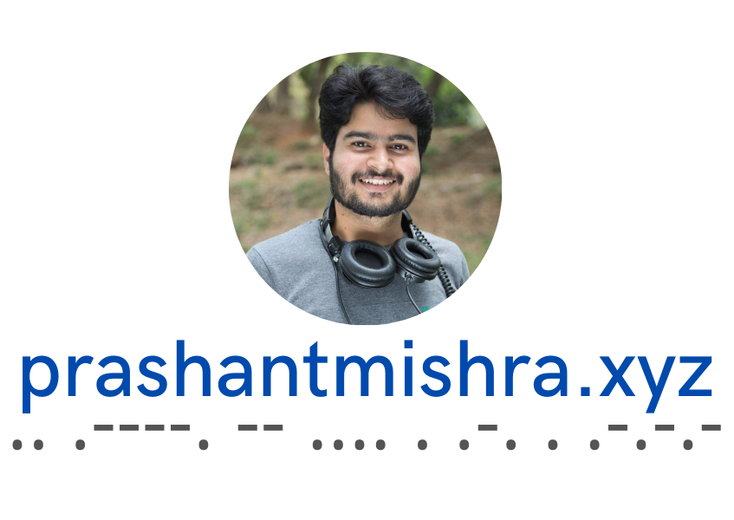
About me
I’m listening
Love to set up creative collaboration
Audio Director
Product Creator
Educator (Wwise Certified Instructor)
Audiophile

Slide 7
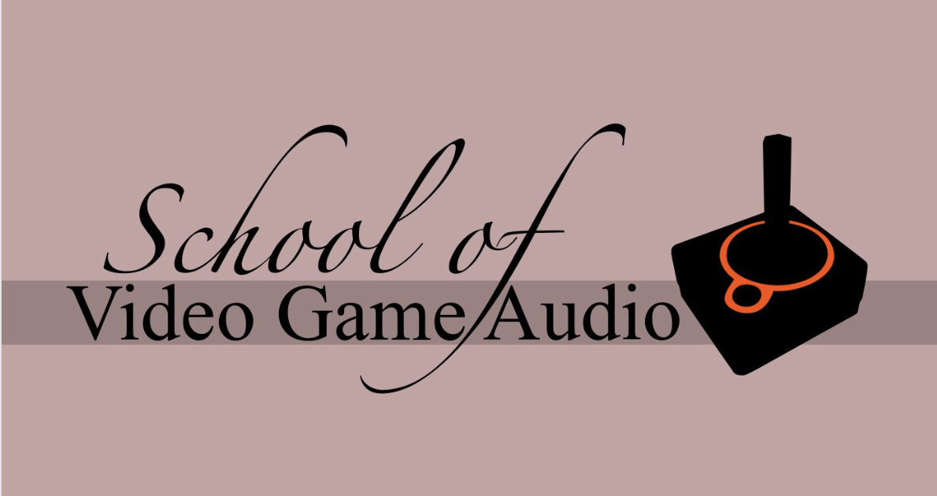
Initiatives & awesome people I’ve worked / work with

Slide 8
Why discuss ‘Audio’ in a game developer conference?

Slide 9
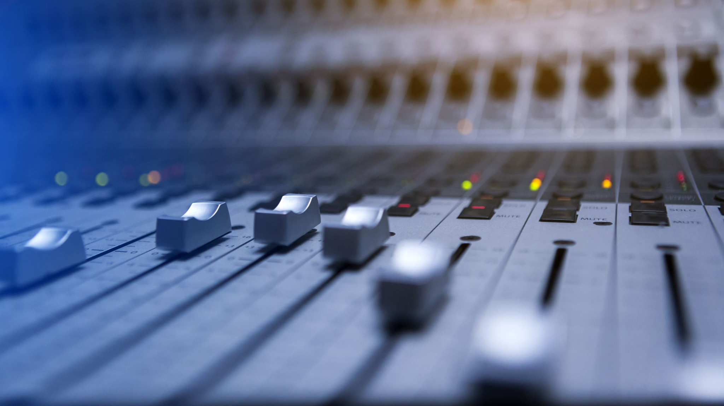
Sound is 50% of the experience, right?

Slide 10
In games, sound is NOT 50% of the experience
and neither is game mechanics nor the visuals / other elements.

Slide 11
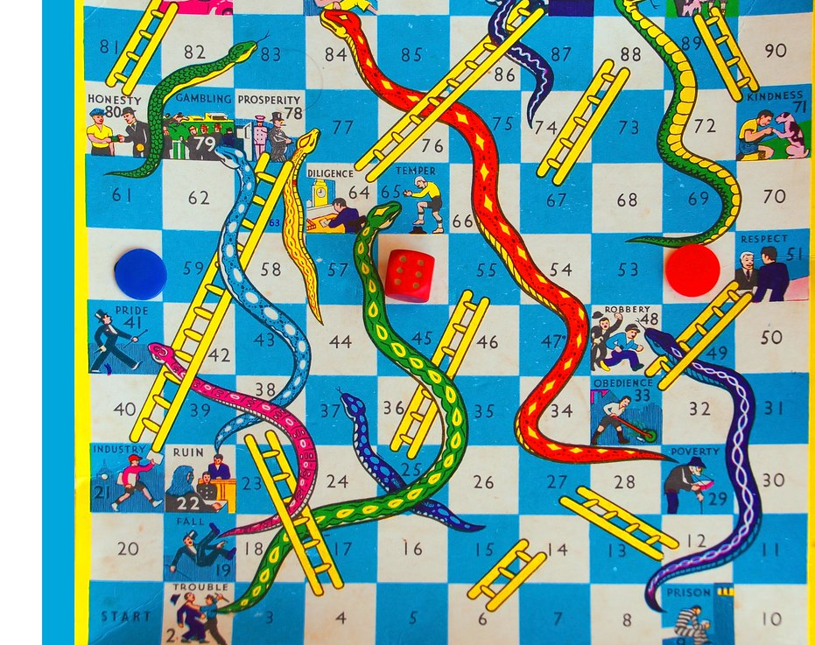
Let’s revisit Snakes & Ladder
Image source: https://live.staticflickr.com/3784/9720925815_3868e28b08_b.jpg

Slide 12
Essence of the game is what makes it fun. Elements such as game mechanics, story / narrative, visuals, sound, haptics etc, make it MORE fun.

Slide 13
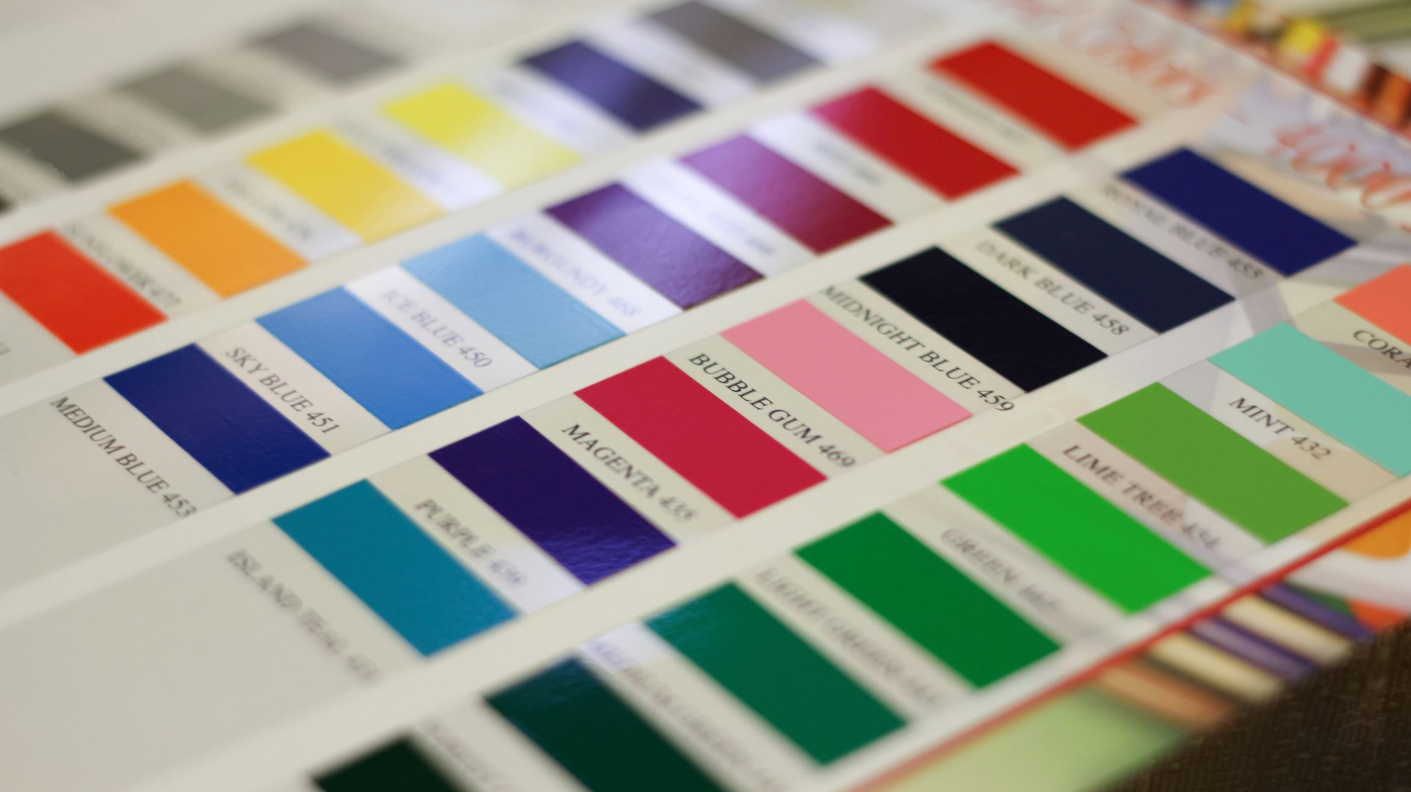
Expand your palette.

Slide 14
Hence, the need to build a Game Audio Mindset

Slide 15
Defining ‘Scalable’

Slide 16
Thinking Scalable
Expanding one game or building many prototypes

Slide 17
WE HEAR BEFORE WE SEE
How does Audio help our games?

Slide 18
Audio – beyond the clichéd ideas
Low Effort, High Impact
Sonic Identity
Conveys gameplay information
User retention & returning users
Extra revenue
Localisation
Accessibility
Audio Ads
A world beyond the game

Slide 19
Key elements that every game creator must know about audio

Slide 20
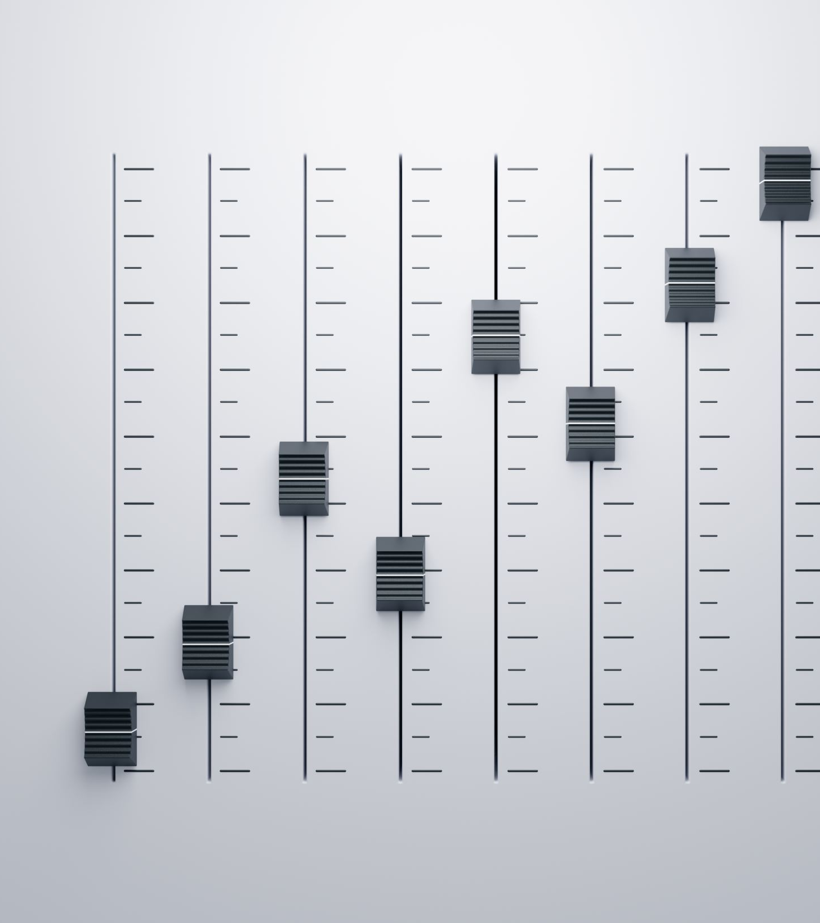
Sound Effects (SFX)
Ambience
Voice Overs (VO)
Music (BGM)
Musical Cues
Effects
Instruments
Mixing
File Size (Budget)
RAM vs CPU
Game Design Thinking

Slide 21
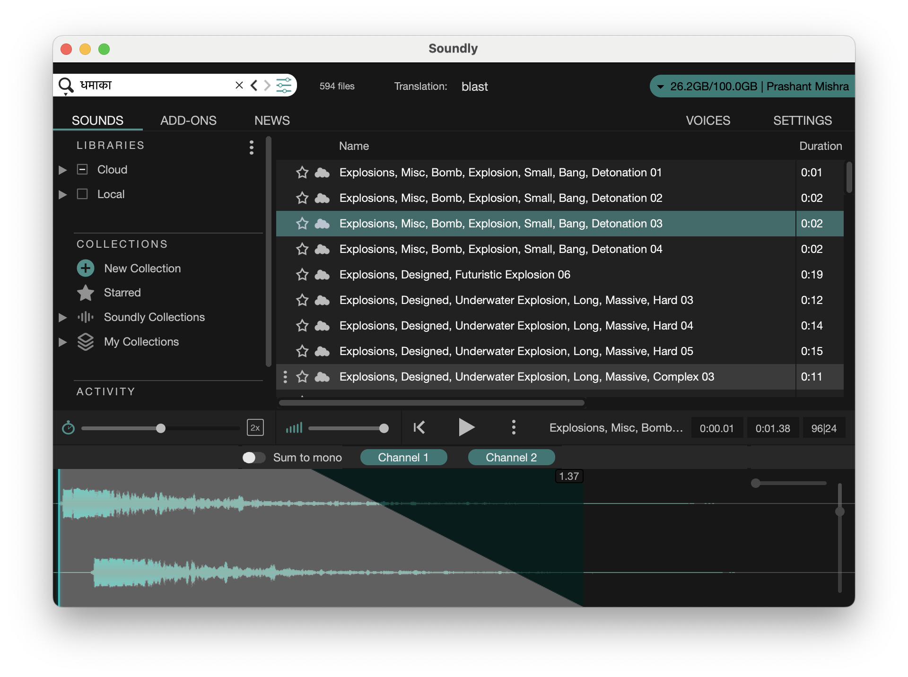
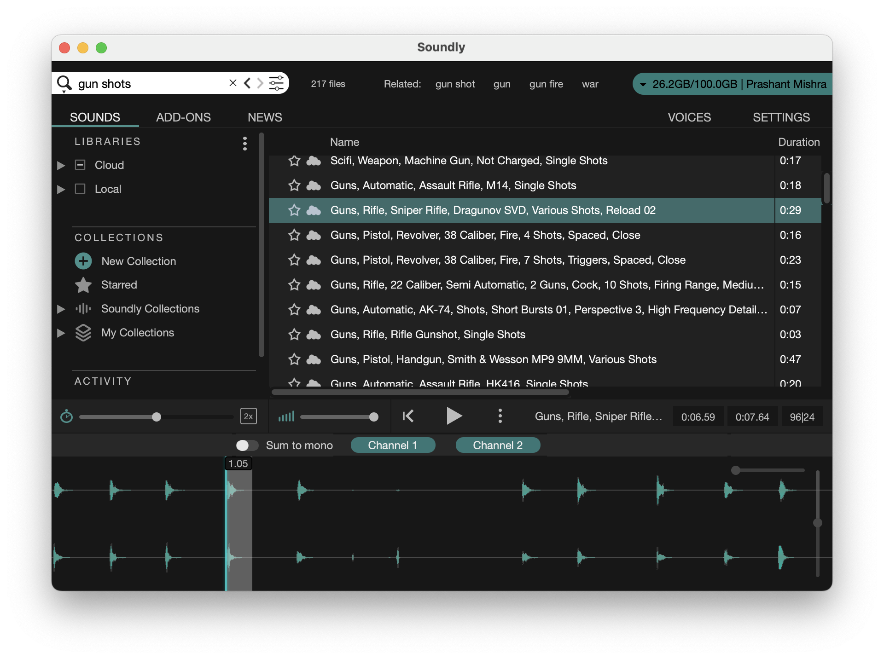
Sound Effects (SFX)

Slide 22
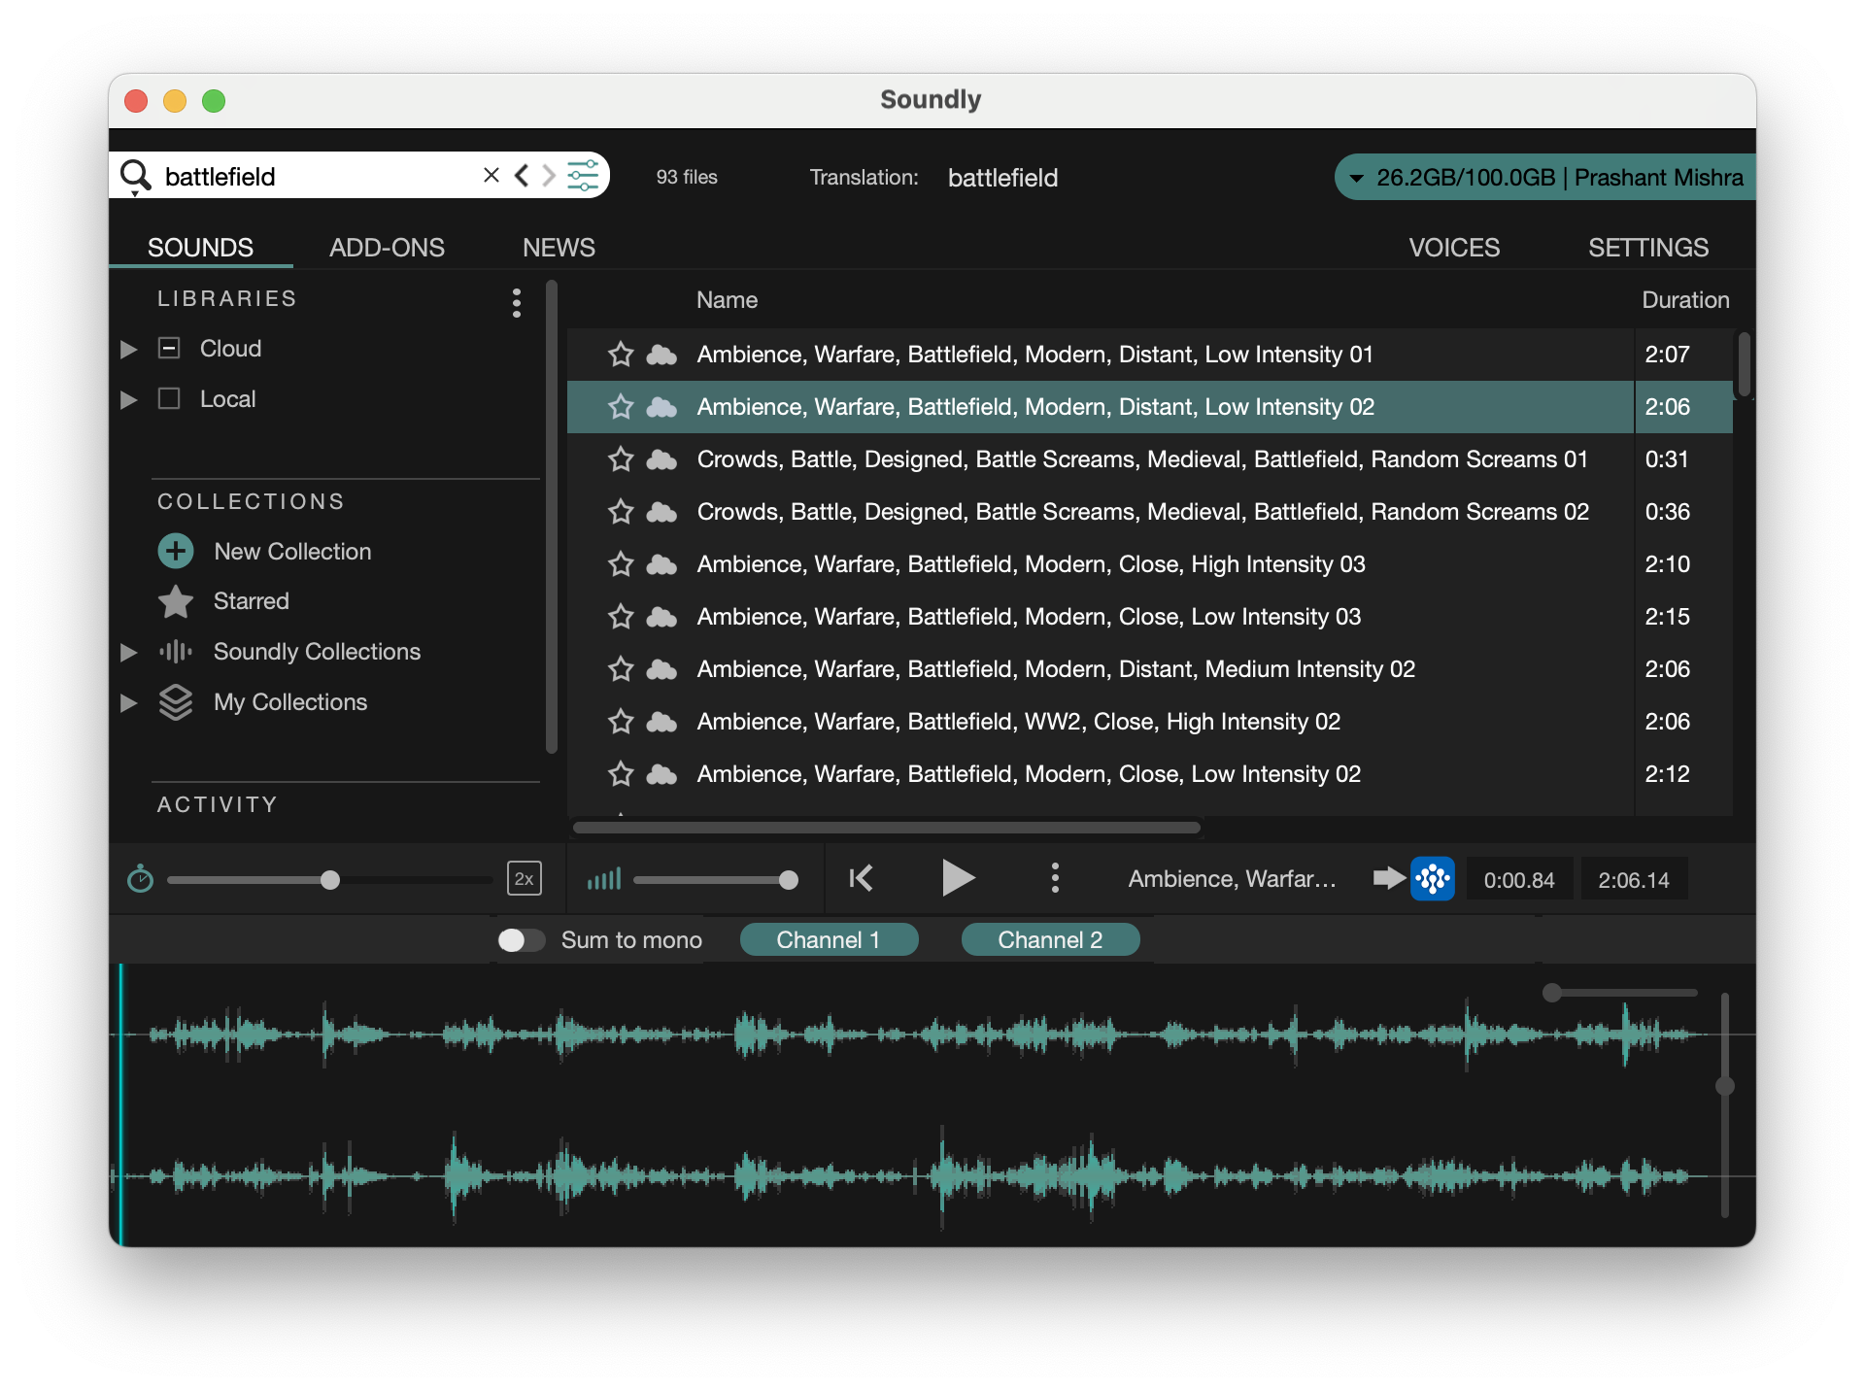
Ambience

Slide 23
Why use Voice Overs?
Reading text on screen takes away all the focus from the awesome art and visuals
If used wisely, Voice Overs can reduce the cognitive load
Voices can be used for sonic IP (Mascots & characters)
Does not have to be dialogues (for example a character might have a particular style of giggling)

Slide 24
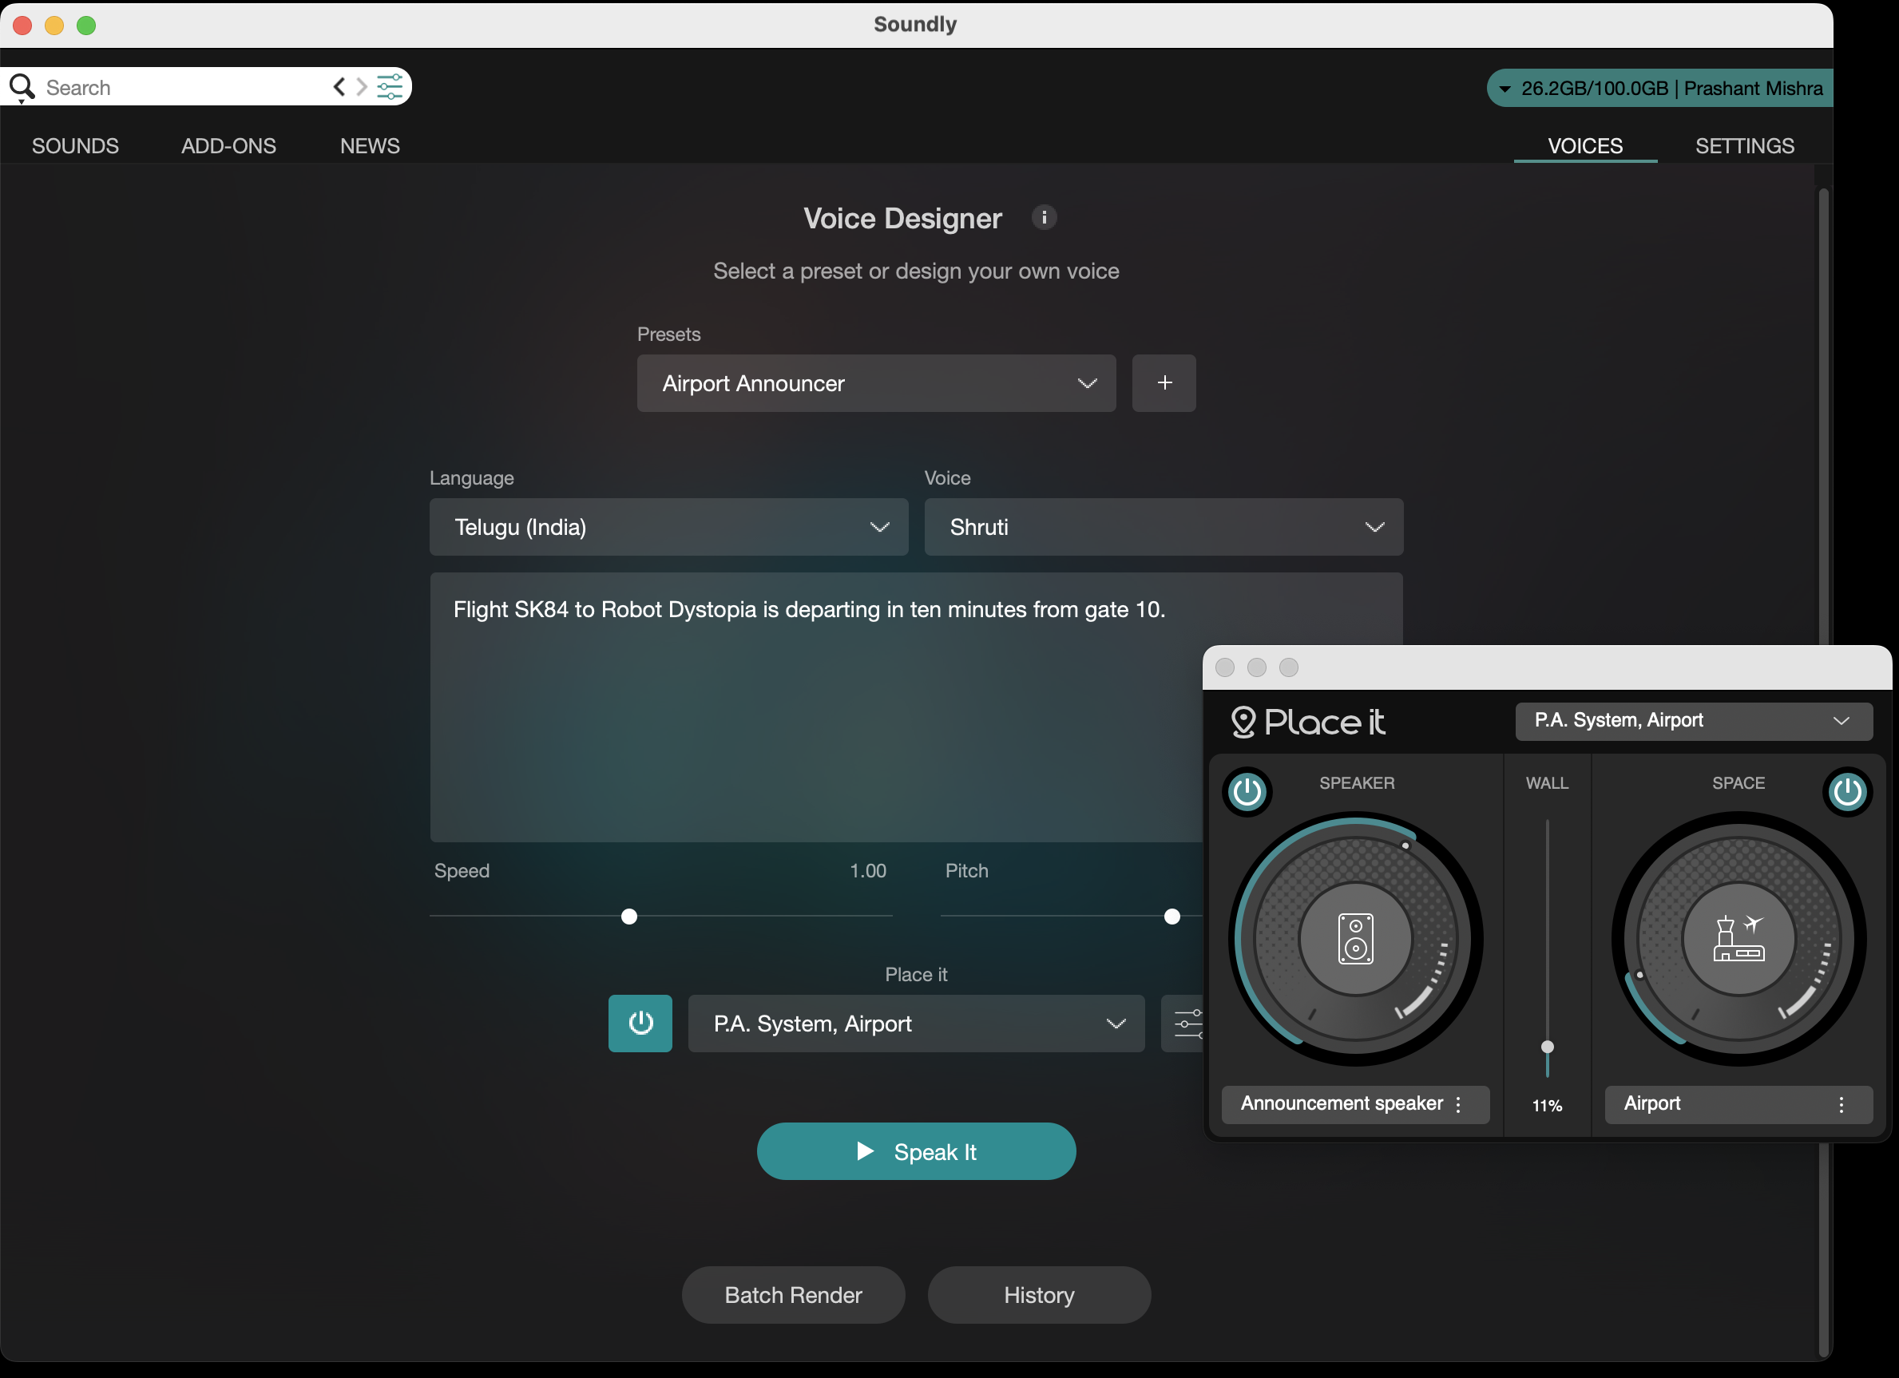
Voice Overs

Slide 25
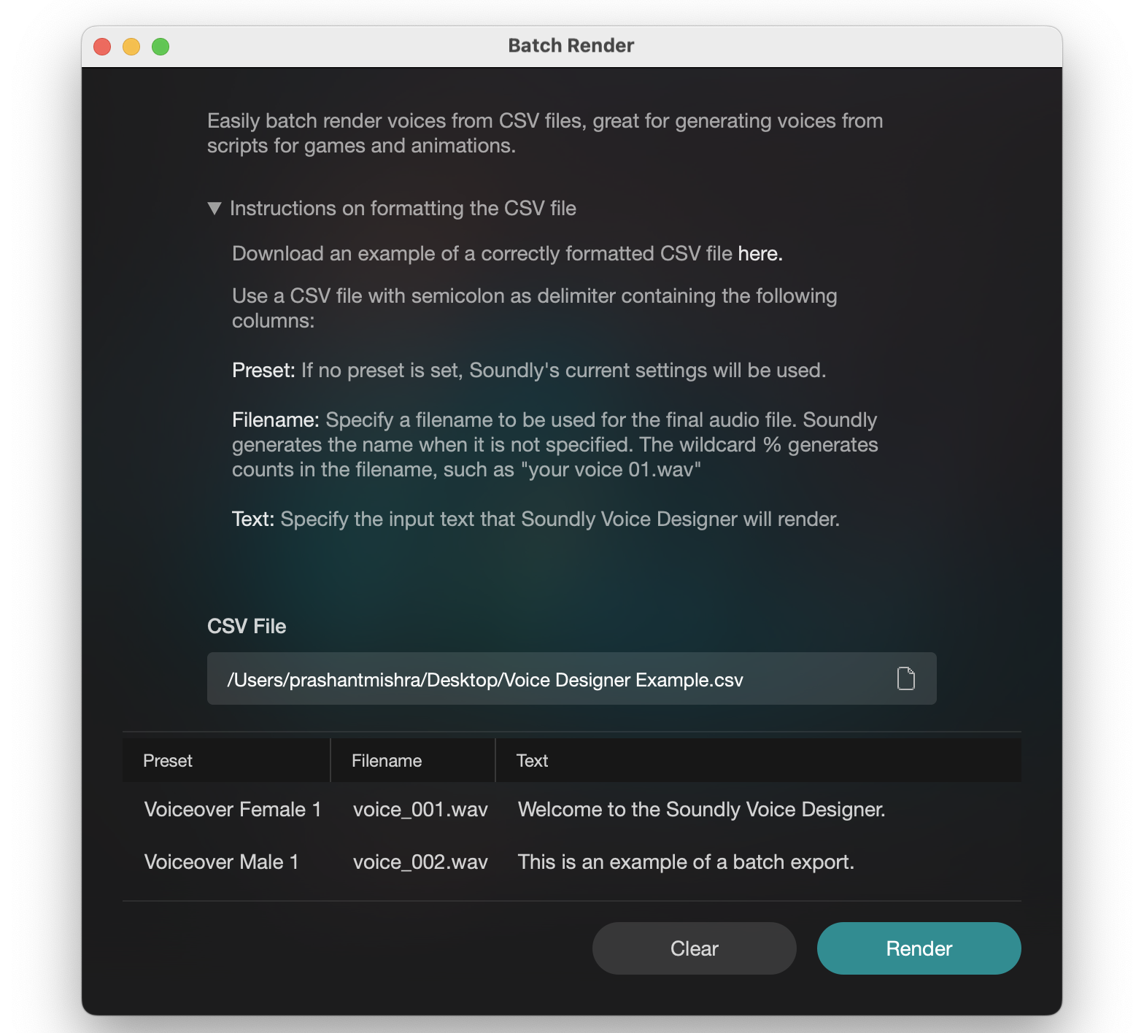
Voice Overs

Slide 26
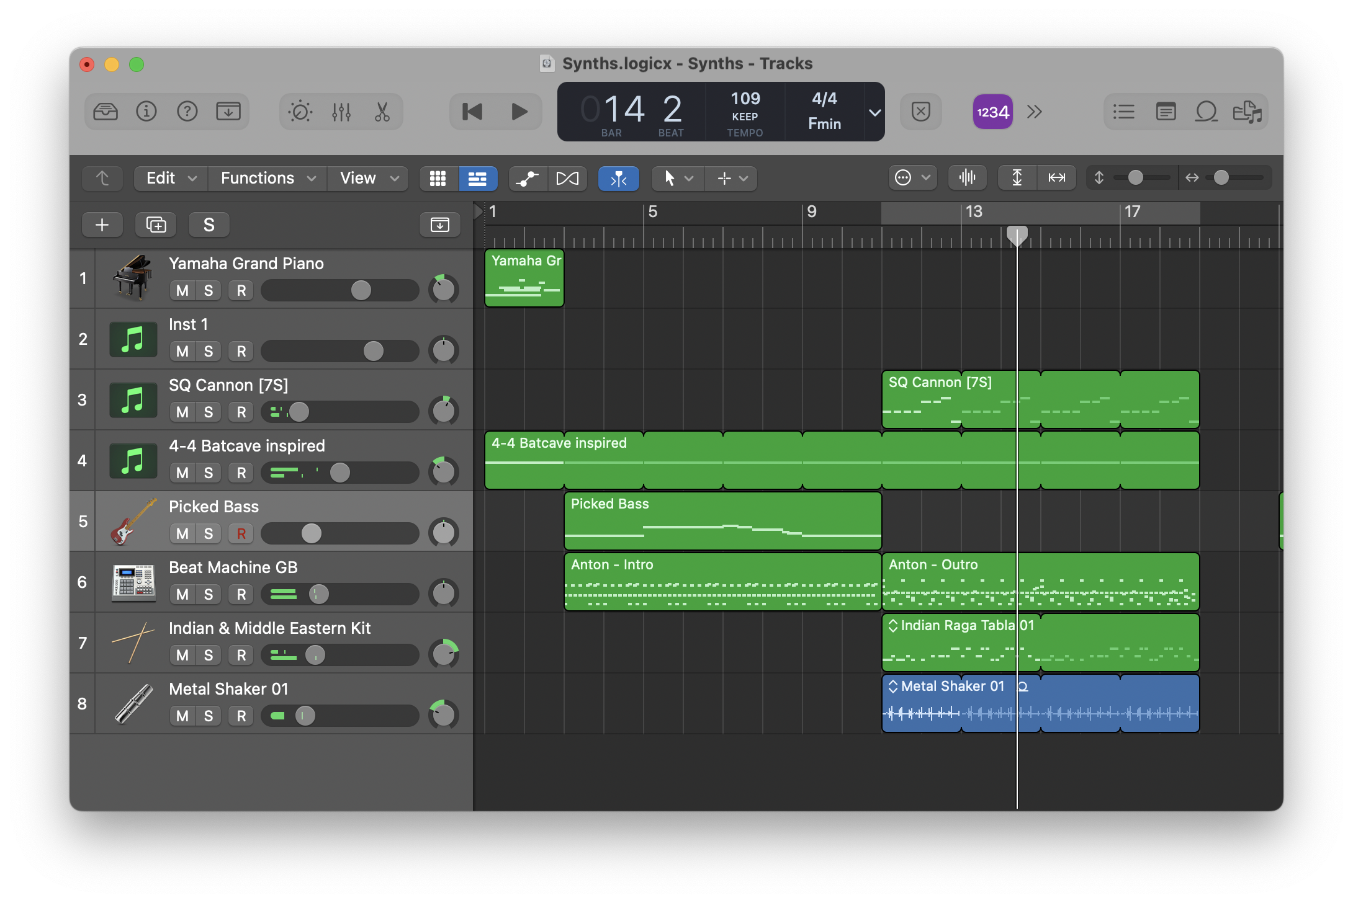
Music (BGM)

Slide 27
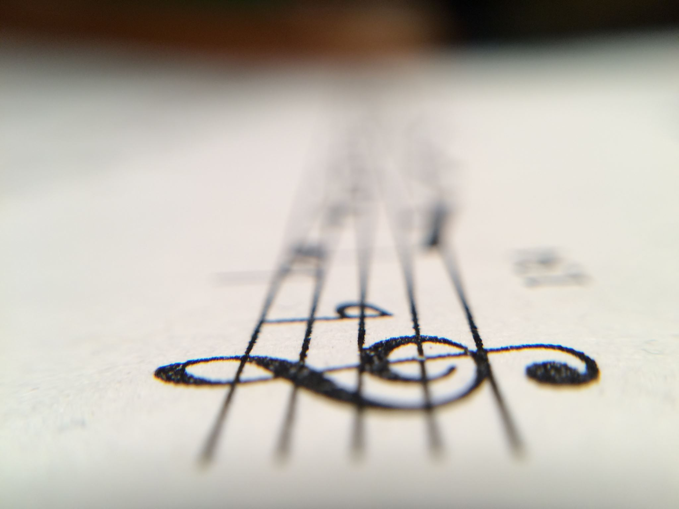
Music (BGM)
Approach: Horizontal vs Vertical
Transitions: Cross fades vs Rhythmic changes (Better Adaptive Music – BAM by Kejero)

Slide 28
Short piece
Delight and big moments in the game
Sonic IP (such as using in Cypher)
Musical Cues

Slide 29
Audio Effects
Reverb
Delay
EQ
Compression
Ducking
Flange
Distortion
Chorus
And many more

Slide 30
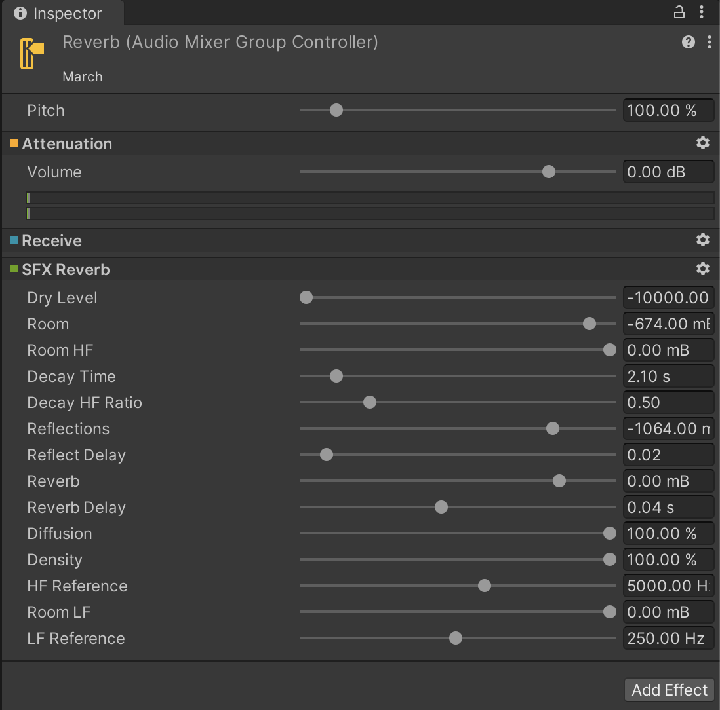
Audio Effects

Slide 31
Instruments
Image source: https://www.audiokinetic.com/en/courses/wwise201/?source=wwise201&id=using_midi_filters

Slide 32
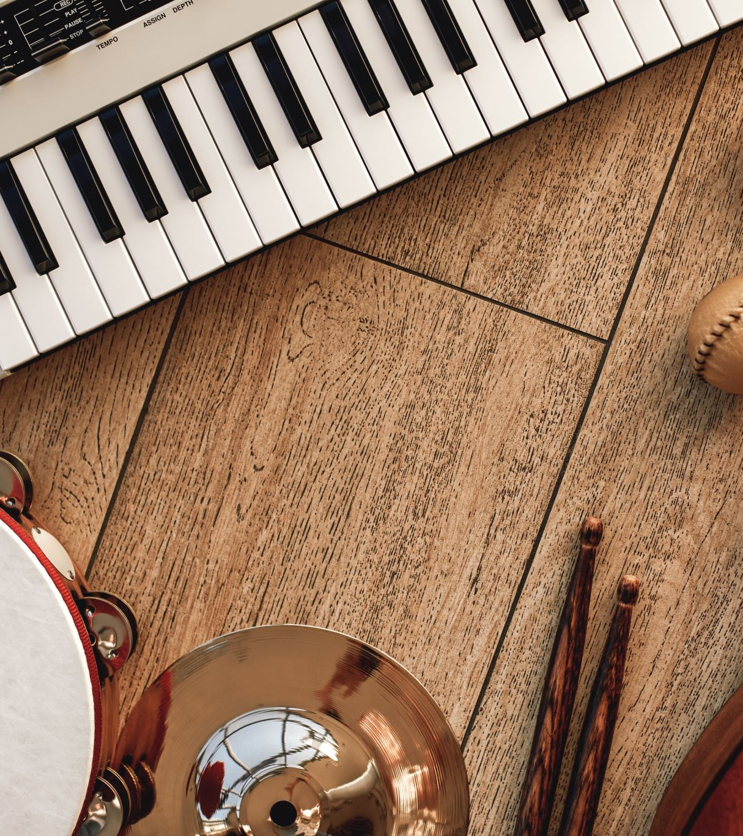
Instruments
Explore MIDI and custom instruments for versatile music in games, especially with a lot of flexibility with the vertical approach

Slide 33
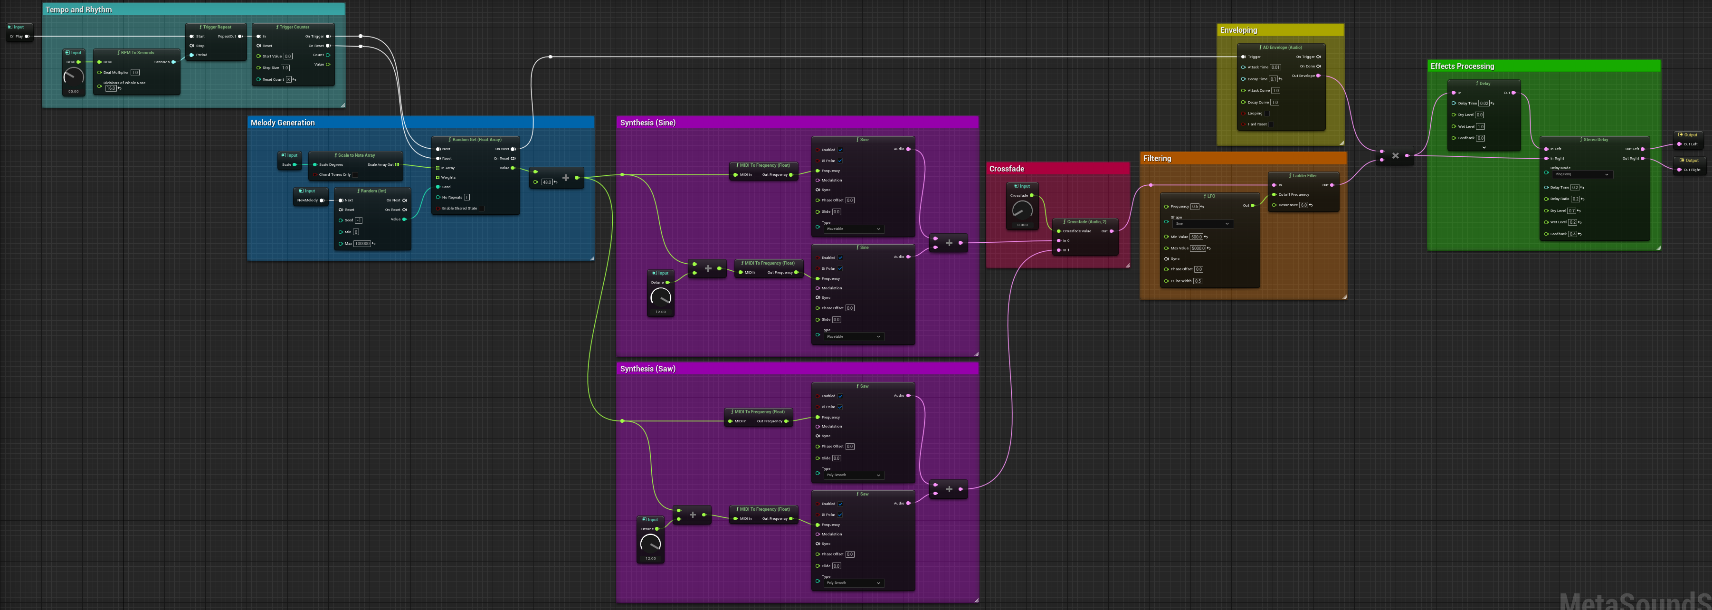
Procedural Audio
Image source: https://docs.unrealengine.com/5.2/en-US/creating-procedural-music-with-metasounds/

Slide 34
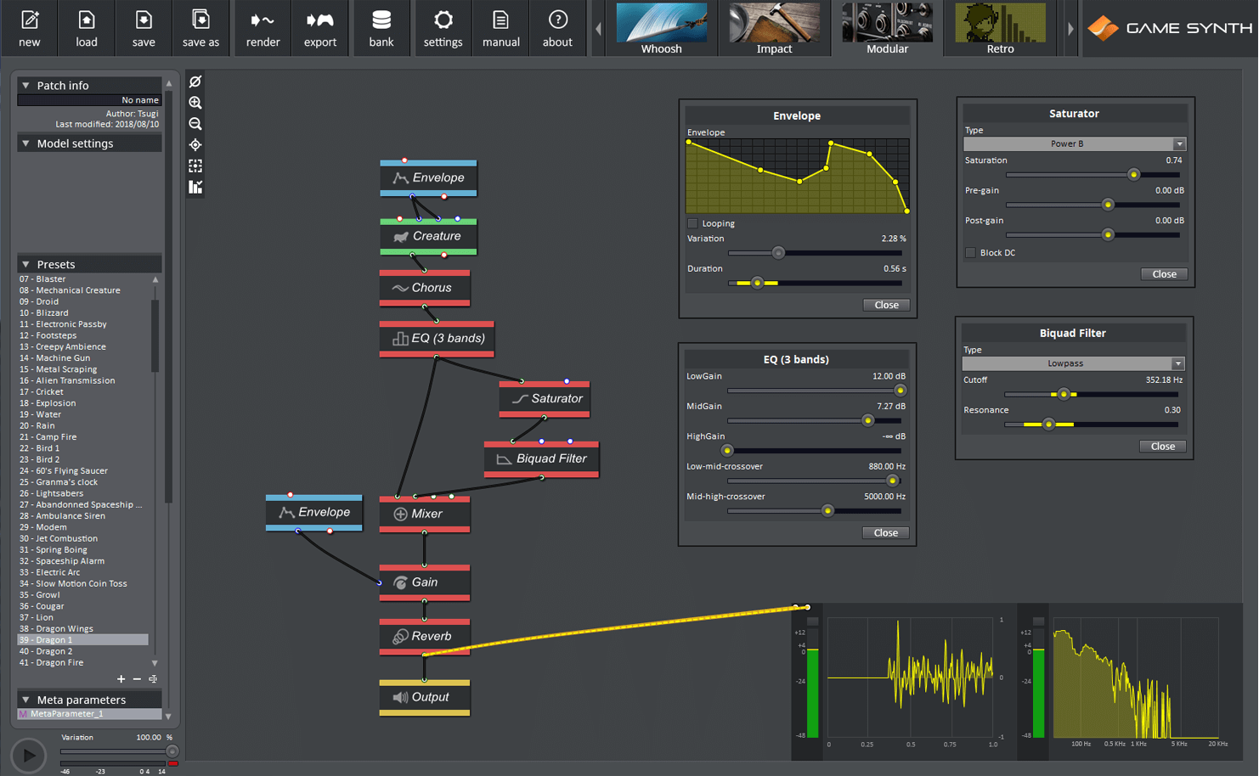
Procedural Audio
Image source: https://www.synthtopia.com/content/2022/04/01/tsugi-intros-bigger-faster-smarter-gamesynth-2022/

Slide 35
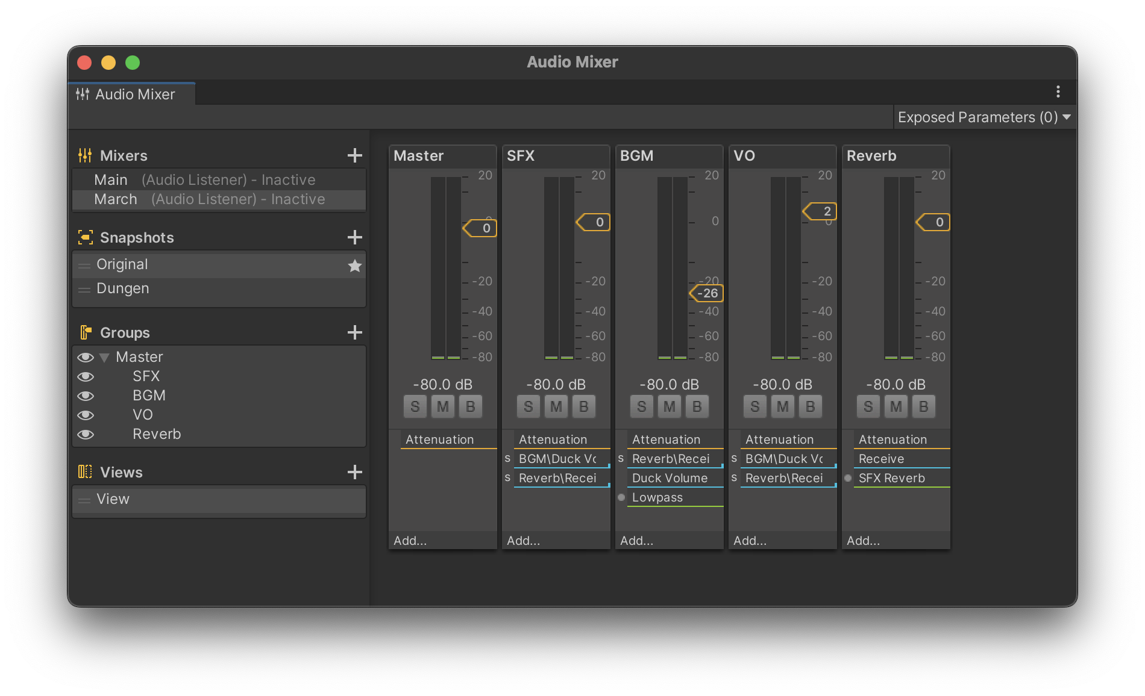
Mixing

Slide 36
Other key elements to consider in Game Audio
File Size & Formats
RAM vs CPU
Game Design Thinking:
Rhythm based gameplay (BPM)
Notification Sounds
Subconscious hints about what’s coming next through music
Sonic clues in puzzle games
Think more!

Slide 37
Deciding a Tech Stack

Slide 38
To cut a potato, you don’t need swords. A knife will do. - Prashant

Slide 39
Things to consider when deciding a tech stack for Game Audio
Features Required
Middleware vs Game Engine’s in-built options vs Custom Audio Engine
Budget
Technical skills available in the team
ML / AI / Other extensions

Slide 40
Features Required
Based on elements of audio discussed earlier
Custom DSP (and possibly protect your IP)
Interaction with 3rd-party services
Such as PACE (https://paceap.com/unity/)

Slide 41
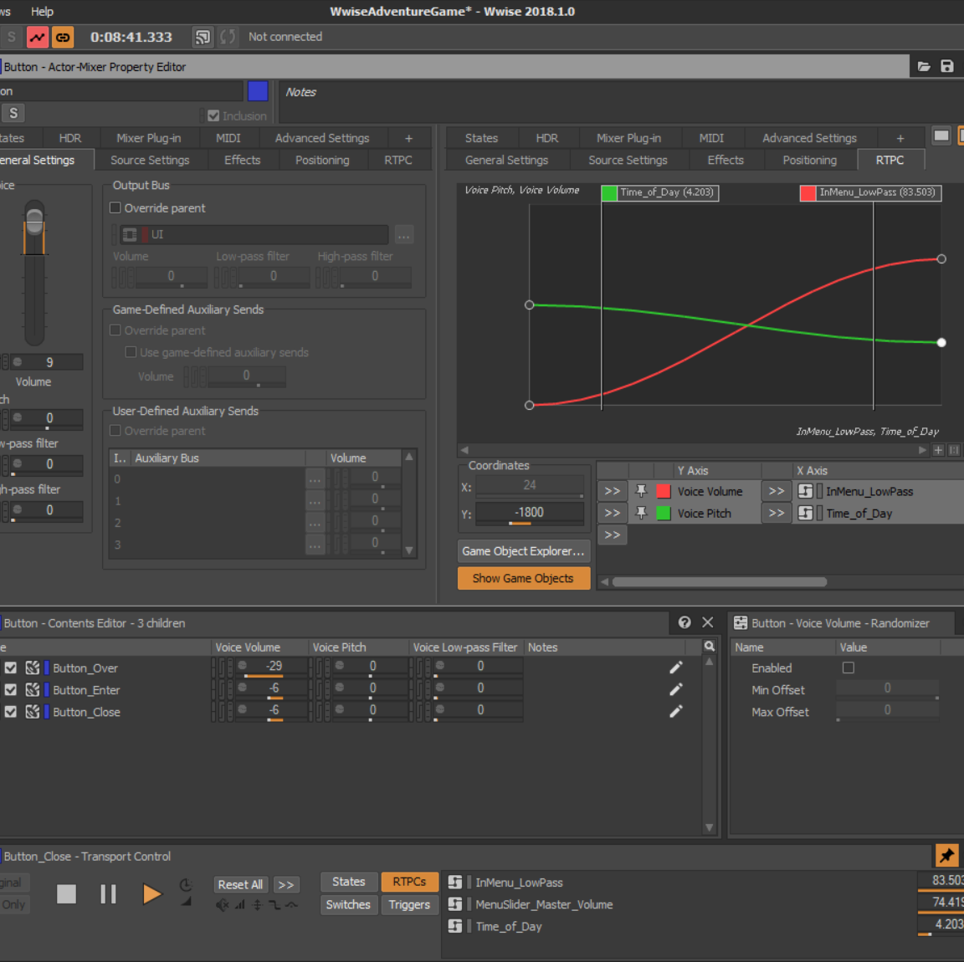
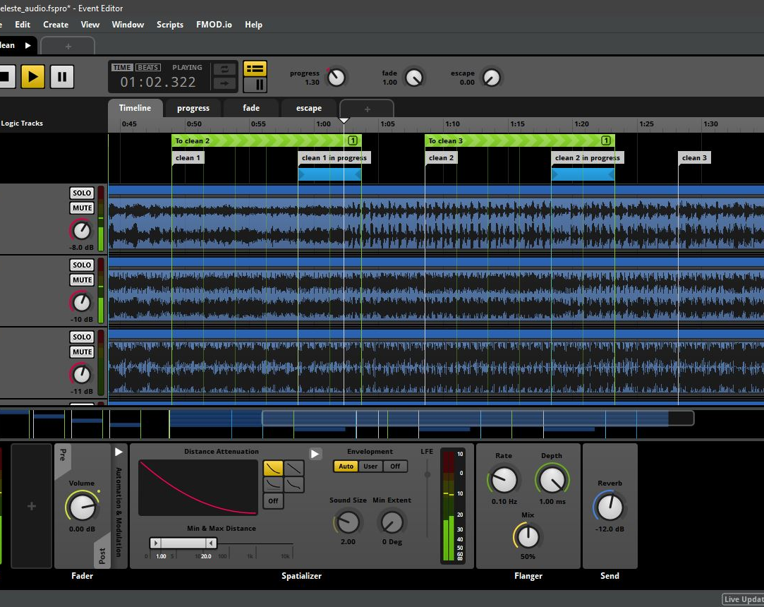
Middleware – Do we really need it?
A lot of flexibility
Free-tier is usually available for Indie game creators (Wwise recently added this option as well)
Audio-folks-friendly
Generates the necessary code automatically
File size & budget management
Easy & customized file conversions
Detailed debugging
Detailed documentation
Wwise
FMOD Studio

Slide 42
Full deck is available on the link coming up at the end of the talk

Slide 43
Middleware – Do we really need it?
Things to consider:
Making minor changes in the proprietary code is risky
Often requires developers to know the middleware too for engine-side integration, besides the audio team
Can get expensive for high budget games

Slide 44
Making it all scalable
Scalability can be achieved with 2 main strategies:
Modular approach
Building Templates & Presets

Slide 45
Modular Approach
Write reusable code
Explore effects bus
Use Audio Manager approach for repetitive elements such as music & ambiences

Slide 46
Templates & Presets

Slide 47
Templates & Presets on Creative Audio
This is a basic approach to be explored in collaboration with audio teams & developers to create reusable inventory.
Templates & Presets are the starting point and aim to provide a head start in the audio implementation process.

Slide 48
Templates & Presets
Example:
Prepare a set of SFX, ambiences, BGM, VO assets to begin with (ensure they are mixed and levelled for consistency)
Document & set up file nomenclature including information such as Mixer channel, type of asset and variation information
Use a basic project in game engine to experiment with their parameters in the game engine / middleware to set suitable audio loudness levels for each type of audio element as required for the genre

Slide 49
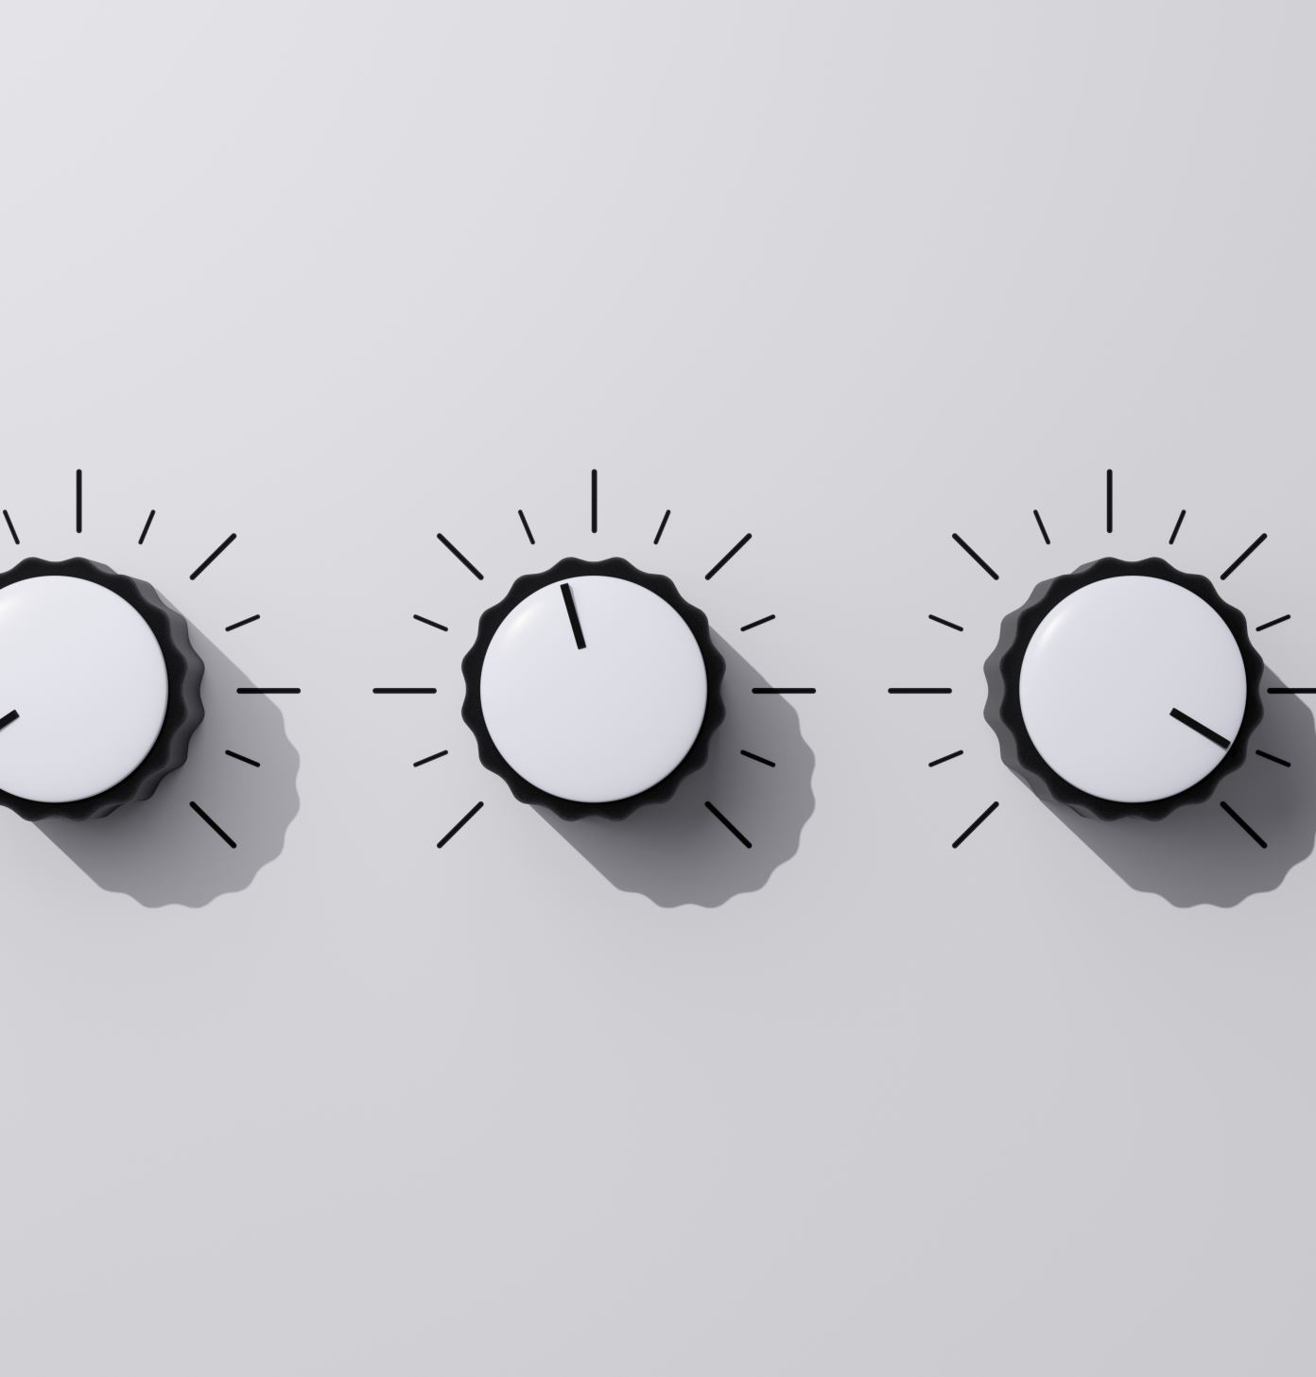
Templates & Presets
Include effects such as Reverb etc and scenarios such as ducking and buses
Include code to switch between mixer snapshots or Audio Source parameter changes based on an incoming value (ensure that the incoming value is not hard-coded)
Save the mixer values and parameters in your Inventory to be used on other games
Set up a process to verify the build in the target devices for final decision on the mix Prepare an iterative QA checklist and add to it as more experiments are done
Note: The values will require changes based on the soundscape aimed. Consider creating genre specific or IP specific presets out of it if that helps your workflow.

Slide 50
Templates & Presets
Further Exploration:
If using Middleware, consider creating template project files
For more control on audio processing, custom DSP can be written
Creating custom MetaSounds Nodes is a good place to explore this in depth

Slide 51
Interacting with Audio Teams

Slide 52
Interacting with Audio Teams
Invest and look for Game Audio Director / someone with similar skillsets
Share GDDs and complete game context with the audio teams to give them visibility into your vision, both from a creative or technical as well as business standpoint
Ideate with audio folks besides working on the current games
Listen to the next game you play & discuss with an audiophile

Slide 53
Resources

Slide 54
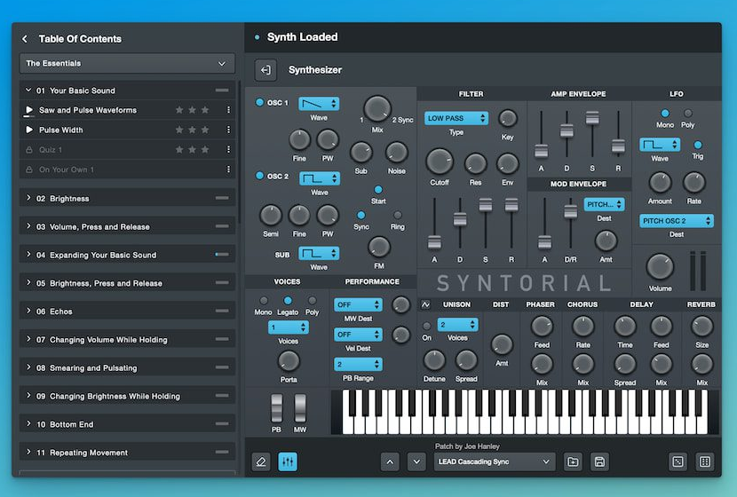
Resources
Procedural Audio
& Synthesis: Syntorial

Slide 55
Resources
Sound Effects, Ambiences, quick Vos with effects: Soundly

Slide 56
Resources
Procedural Audio and GameEngine: GameSynth by Tsugi Studio

Slide 57
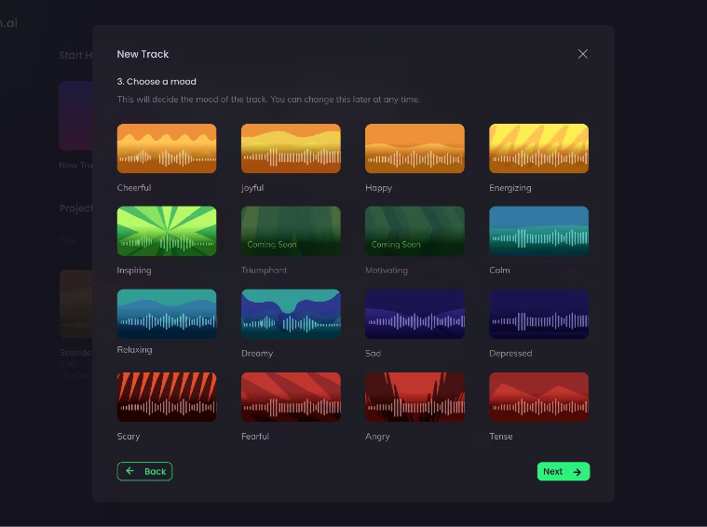
Resources
AI generated music (BGMs): Beatoven.ai

Slide 58
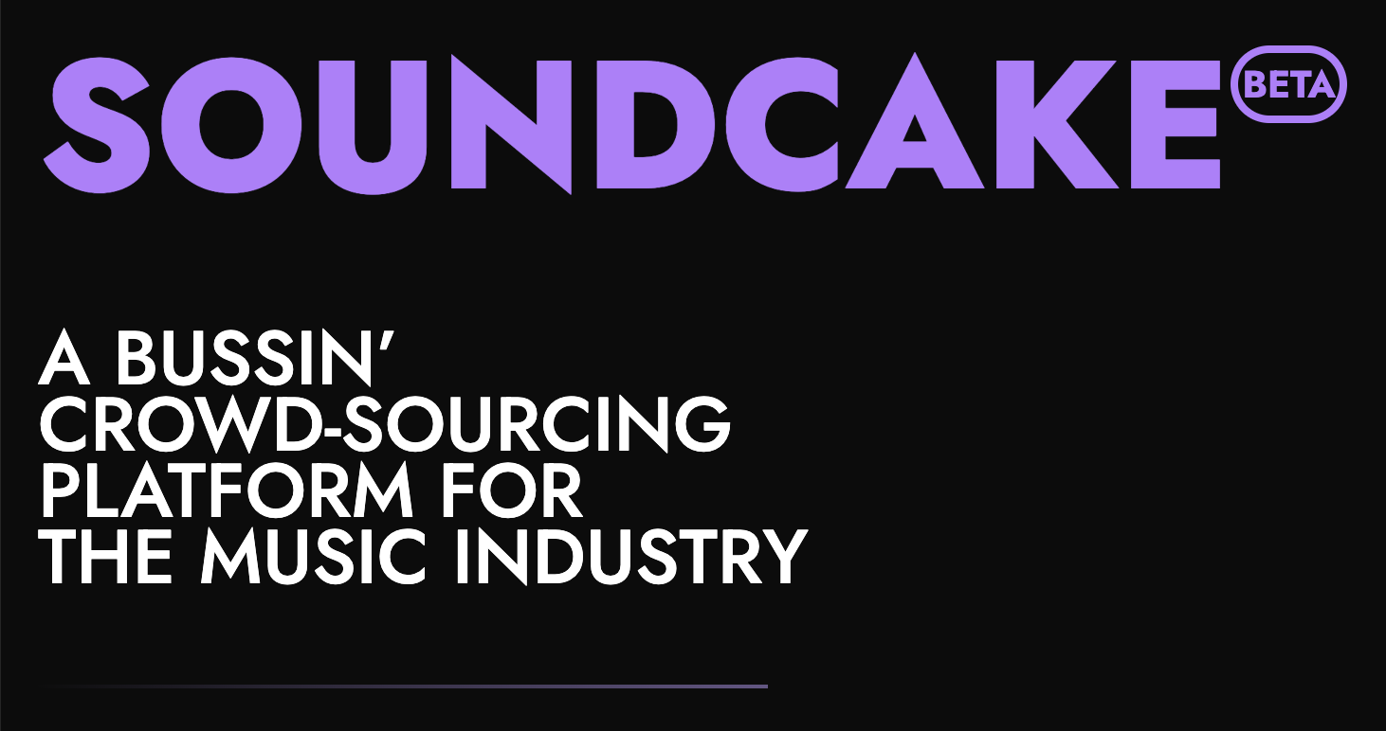
Resources
Custom crowdsourced music: SoundCake

Slide 59
Learning Resources & Communities
Game Audio India: gameaudio.in
School of Video Game Audio: sovga.com
Game Audio Learning: gameaudiolearning.com
Social media for game audio: airwiggles.com
Audio tech & Music tech: ADCx India 24 & Music Hack Day India
audio.dev/adcx-india-24

Slide 60
Summary

Slide 61
Sound is NOT 50% of the experience in games, still, build a game audio mindset to enhance your palette
Game Audio is a collaborative process, so collaborate
To ease the implementation of audio in games, a small effort can bring huge impacts
Build templates and presets, together
Keep things modular to allow reusability

Slide 62
Next steps & vision
In the near future, I’d love to see an Audio track at IGDC
And hopefully, more games from India would win best sound awards on international platform
In general, the awareness about using this tool for immersive experiences would be the new normal

Slide 63
Thank you!
Here are some goodies for you 🎁

